Slide 1

Janjagruti Vidyarthi Sangh
“Making lives better for the unprivileged”

Slide 2
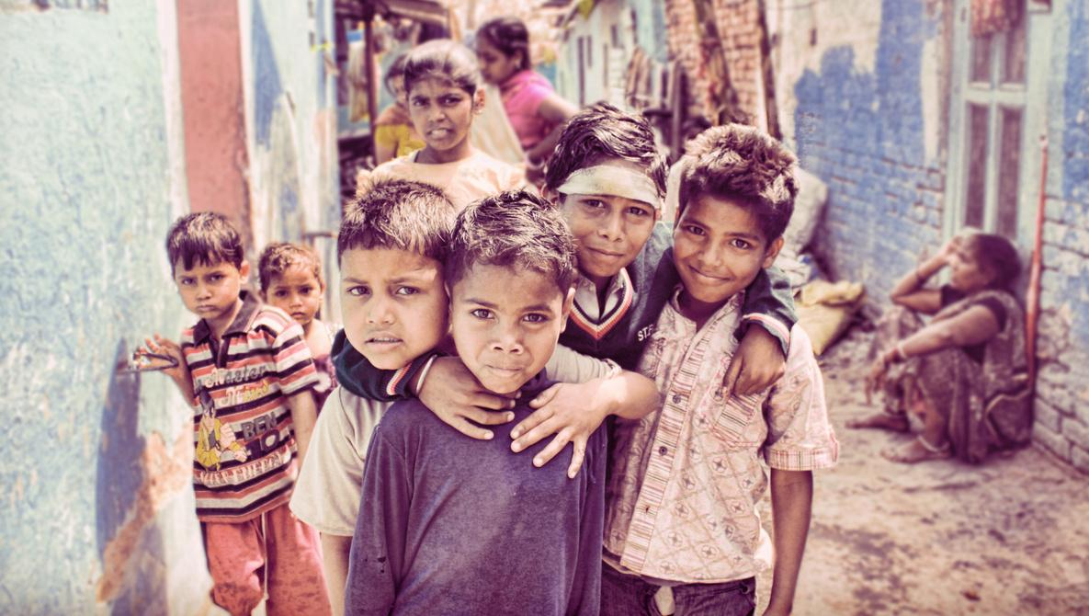
OUR VISION
A WORLD WITH EQUALITY AND JUSTICE
OUR MISSION
TO BRING ABOUT HOLISTIC DEVELOPMENT OF THE COMMUNITY BY ENHANCING THEIR STANDARD OF LIVING, CREATING AWARENESS ABOUT THEIR RIGHTS AND EMPOWERING THEM TO AVAIL THOSE RIGHTS
Photo Source: fstoppers.com

Slide 3
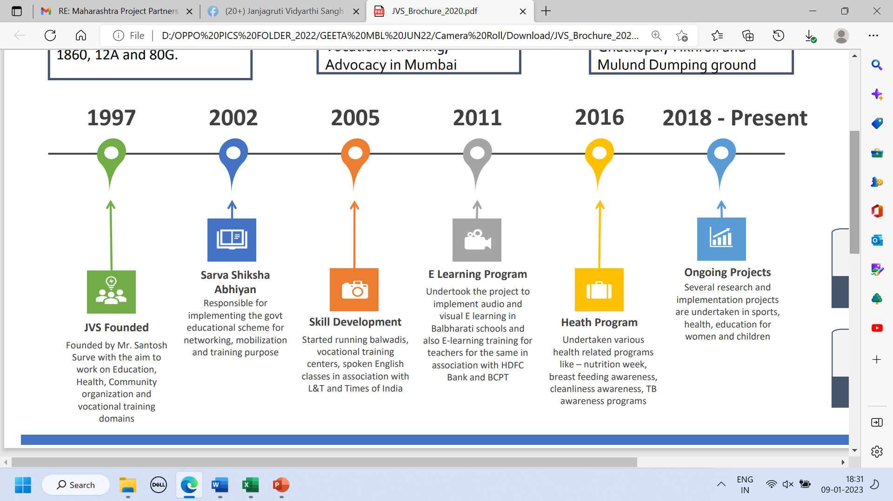

Slide 4
The Problem

Slide 5
The Need
Right to freedom of work
People (especially women) are often victims of marital abuse with no freedom to work and help sustain the family
03
01
02
Right to Opportunities
People residing primarily in slums and from poor families are not aware of opportunities that lie which they can use to run their daily households
Right to Education
Children from slums and unprivileged backgrounds face multiple difficulties to get basic quality education

Slide 6
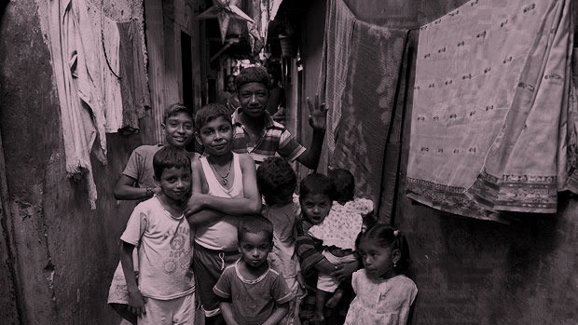
Photo Source: https://www.telegraph.co.uk/news/picturegalleries/worldnews/4248924/Indias-real-life-slumdogs.html?image=6
5.2 million
(42% of Mumbai population live in Slums)
Notes:
Source: https://www.wilsoncenter.org/article/building-slum-free-Mumbai (Mumbai population: ~12.44 million)

Slide 7
What we do

Slide 8
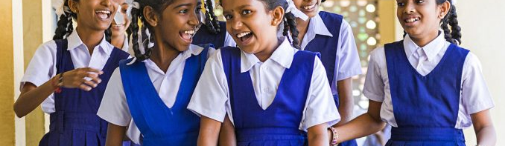
OUR APPROACH
Janjagruti Vidyarthi Sangh runs various programs to empower the community and solve their problems and ensure their sustainability
AREAS IN WHICH WE OPERATE
COMMUNITY DEVELOPMENT
EDUCATION
HEALTHCARE
SKILL DEVELOPMENT
RAIN WATER HARVESTING

Slide 9
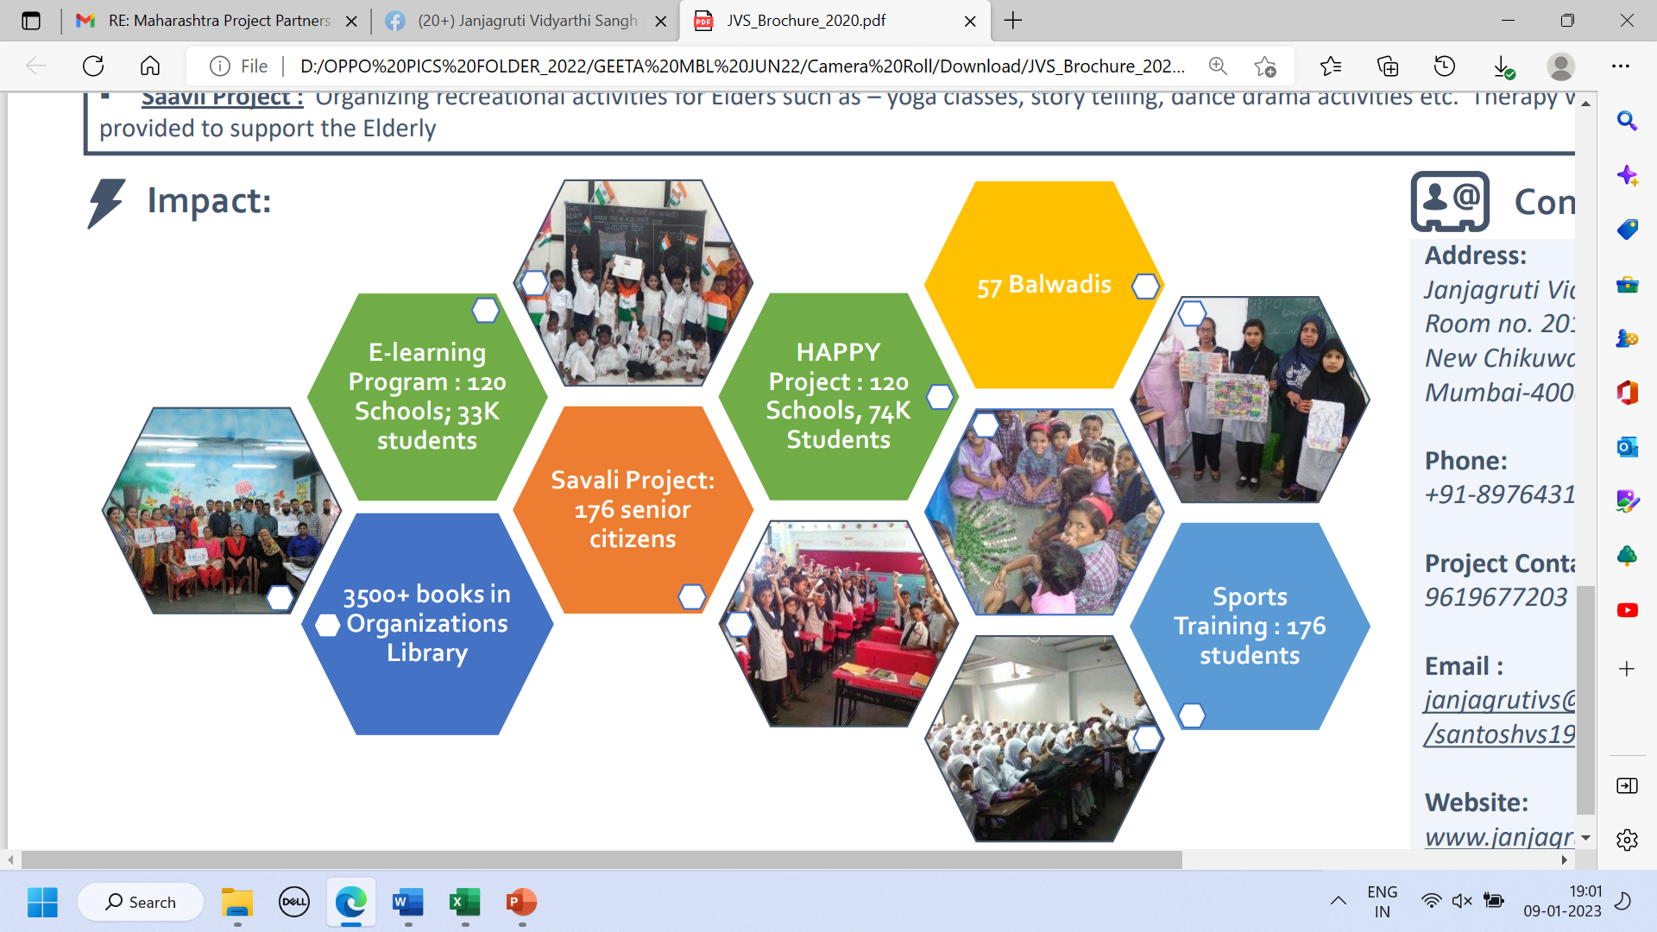
Skill Development
480 Trainees/year

Slide 10
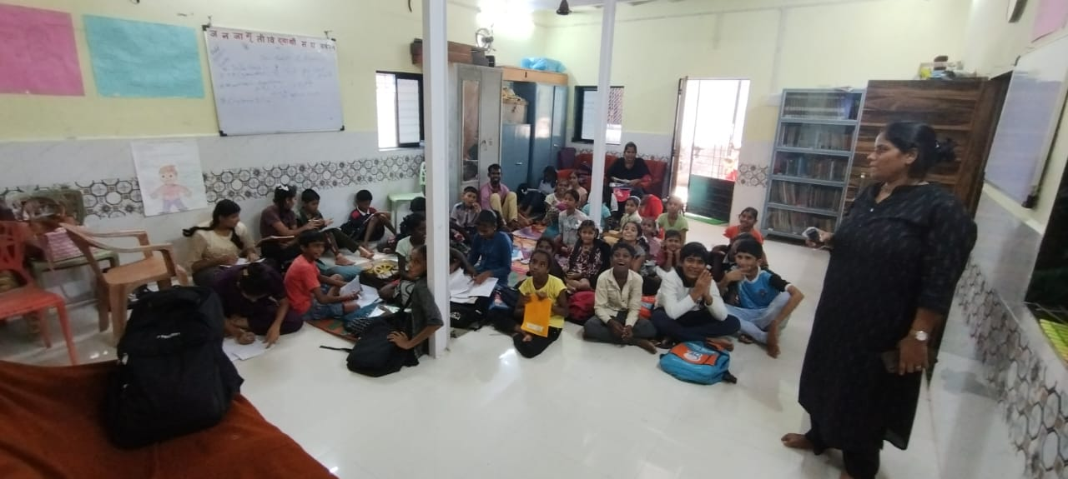
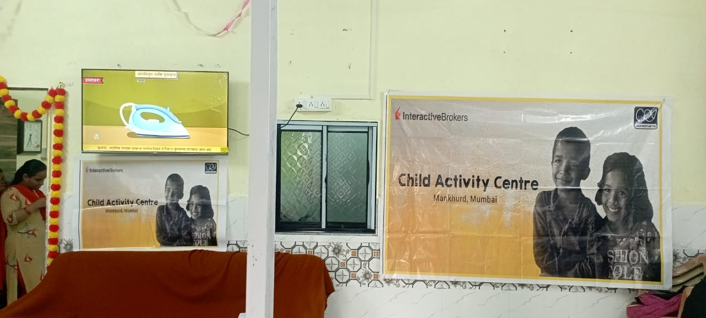
Current Project on Child Rights, Education, De-addiction supported by Child Rights and You
PROGRAM FOCUS ON EDUCATION &
DE-ADDICTION CHALLENGES
IN SLUMS OF MUMBAI”

Slide 11
Janjagruti Vidyarthi Sangh
JVS is working in two areas in M-East Ward, Mankhurd mainly Chikuwadi and Mandala, in these areas JVS is working with total 1000 houses and 2099 children.
In these project locations JVS is having 2 study centers 1 in each area and apart from support classes situated at these locations we also have several activities are ongoing such as Football coaching, peer educator groups sessions, Digital learning centres, adolescent sessions, recreational activities with children, street play groups, value education sessions, mental health sessions, Bal Suraksha Samiti group, networking with partnering NGOs.

Slide 12
Challenges
No BMC Schools in the community
No Civic facilities for larger population
Large number of migrant population and daily wage laborers, relocated families from other states.
Maximum cases of substance abuse
Less numbers of counselling centres and rehabilitation centers to curb the menace.

Slide 13
Highlighted Achievements 2022-2023
Targeted 1000 households and closely working with them on various domains such as education, child rights, documents, dealing with health issues, self empowerment programs, youth development, employment to family members.
Partnering and networking with NGOs - Workshops held on large level for capacity building of NGOs staffs and to strengthen their knowledge in child rights context and laws related to it.
Formation of children groups -peer, sports, adolescent, child parliament.
Formation of parents groups, volunteers, CBOs in the community
Engagement with government bodies such as ICDS, WCD, Education and Health Dept, Asha workers, Nashabandi Mandal, police functionaries.
Active involvement of local stakeholders, school authorities, corporators.

Slide 14
Highlighted Achievements 2022-2023
Running campaign of My Ward, my school, my right across Mandala community.
Organised and conducted Health Camps with 500+ children and parents from both the project locations.
Collaborated with Arpan, PCGT, MPower Foundation, Support organisation for Training, sessions, capacity building etc.
Inaugurated and started de-addiction counselling centre at both the project locations on weekly basis.
Support classes with maximum 300+ children running successfully.
134 students of class 10th and 12th cleared their board exams.
Published articles written by children after attending peer educator training in monthly newsletter and magazine of Nashabandi Mandal, Maharashtra

Slide 15
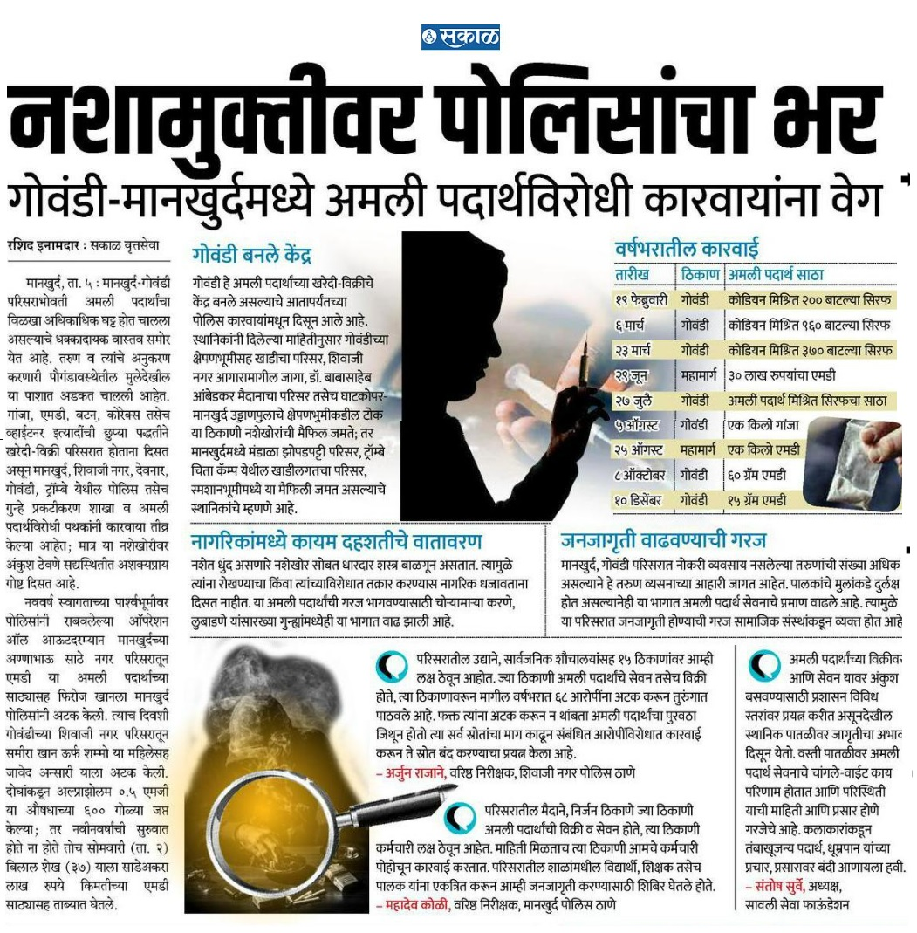
Achievements

Slide 16
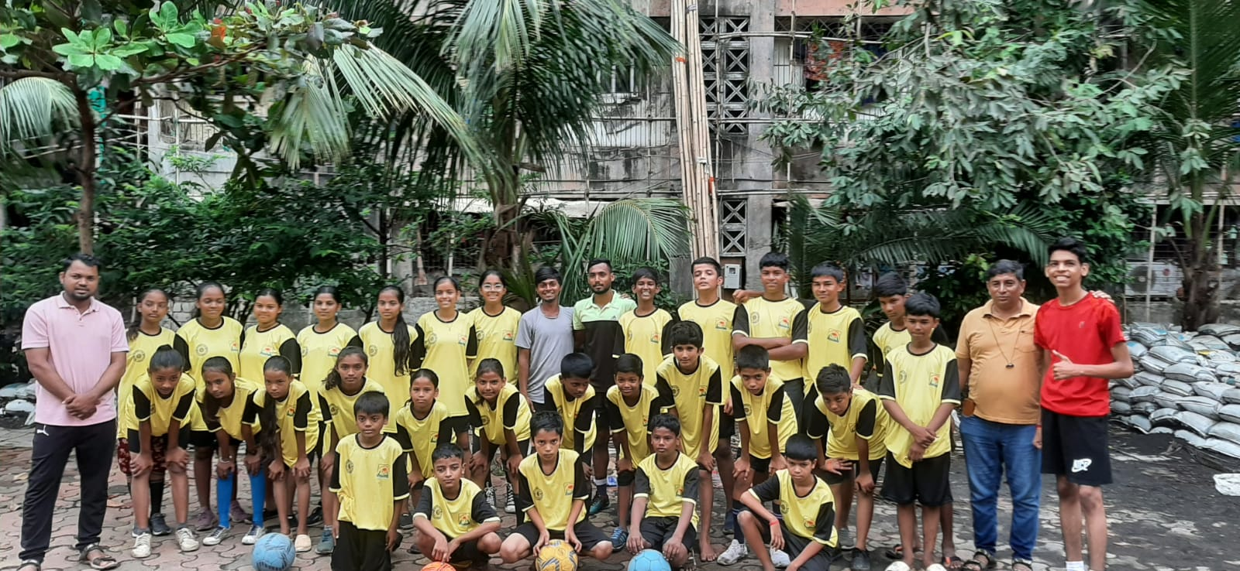
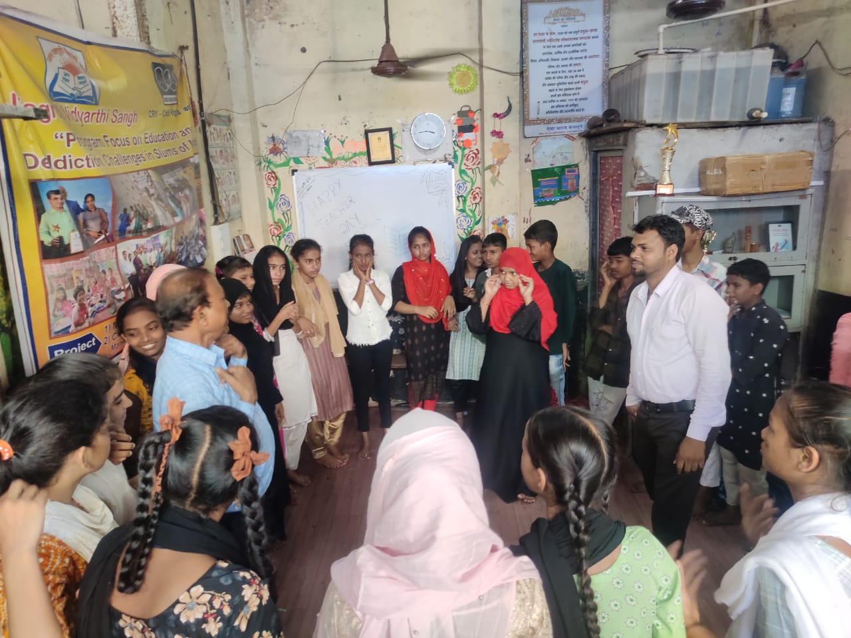
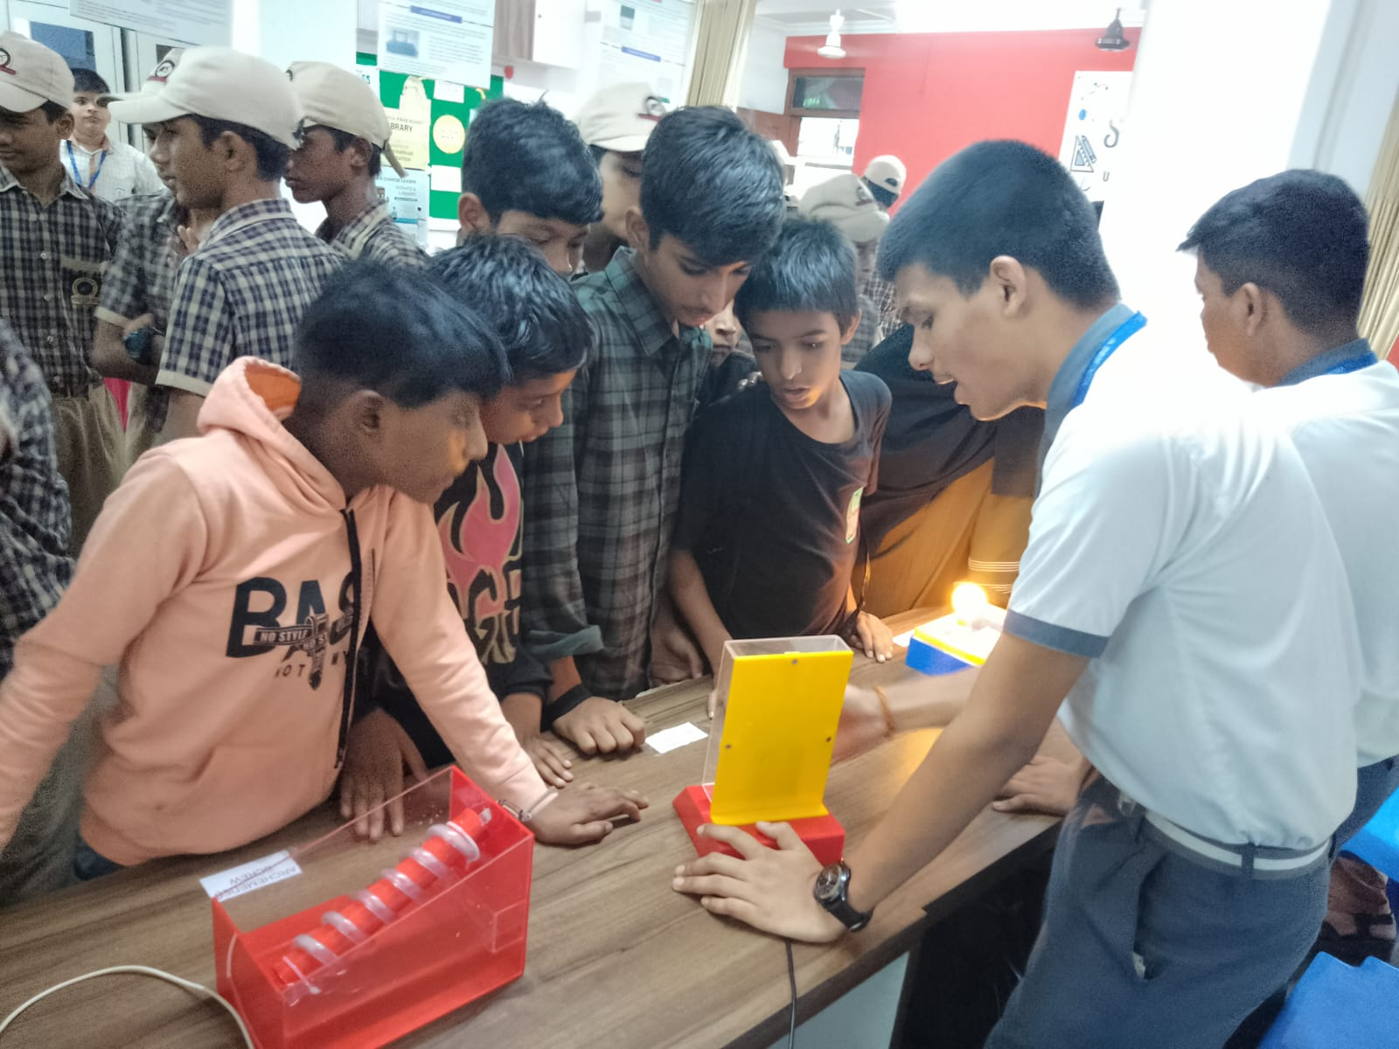
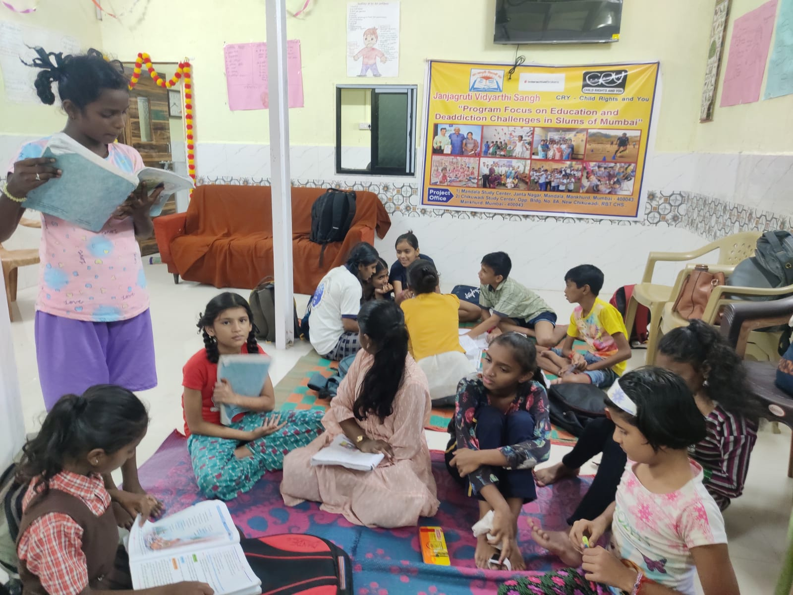
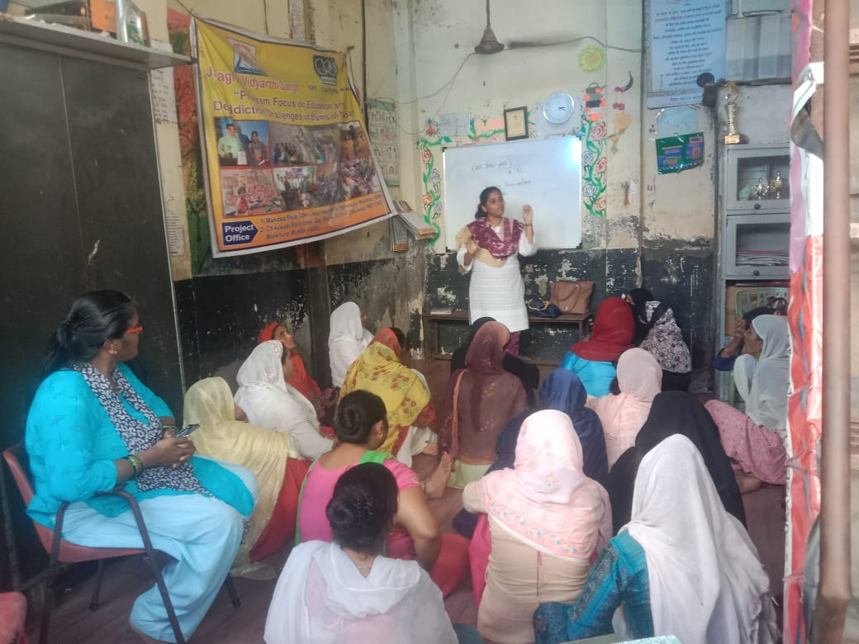
Glimpses of activities

Slide 17

Santosh Surve
Founder Trustee, JVS
janjagrutivs@gmail.com
+91 8976431045
Komal Mastood
Coordinator, JVS
janjagrutivs@gmail.com
For further information please visit www.janjagrutimumbai.org
THANK YOU !

